Slide 1
Pro- and Prebiotics for the Modulation of the Microbiome

Slide 2
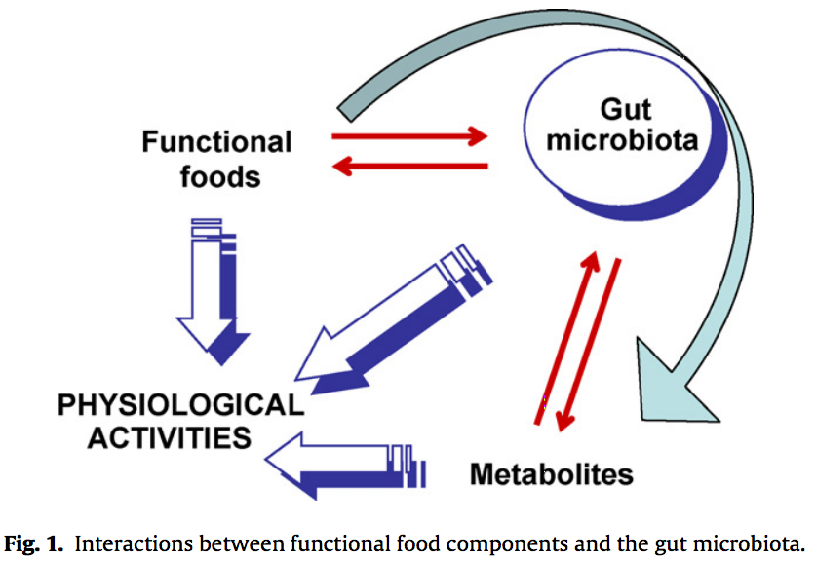
Interactions with Food Components
(Laparra, 2010)

Slide 3
Interactions with Food Components
Gut microbiota exerts great impact on host’s nutritional status
Provides additional enzymatic activity
May be modulated by food bioactive compounds, positively or negatively
(Laparra, 2010)

Slide 4
Probiotics Defined
“Live microorganisms that, then administered in adequate amounts, confer a health benefit on the host.” (Araya, 2002)
Historically, bifidobacteria and lactobacilli
Identification of probiotic strains continues to be aided by genome mining and comparative genomic studies (Kleerebezem, 2009)

Slide 5
Are Probiotics Effective?
For rational use, we must consider the:
Importance of live bacteria administration
Amount of bacteria to be administered
Benefits for the host
Safety of use
(Aureli, 2011)

Slide 6
Are Probiotics Effective?
Some positive effects of probiotics are well documented (e.g., reduction of intestinal discomfort; contrast intestinal pathogens by direct antagonism; prevention of infectious diarrhea in children)
(But still highly strain-specific…)
(Aureli, 2011)

Slide 7
Probiotics and Obesity
Animal studies have provided plausible mechanisms of action of gut microbiota to regulate weight
No consistent evidence of which specific microbes cause or correlate with obesity
Likely some role of gut microbiota, but further metagenomic analyses and functional genomic studies are required
(Sanz, 2013)

Slide 8
Animal Models of Probiotic Modulation
Colonizing germ-free mice with human baby flora allows top-down view of host response to probiotic intervention
Exposure to L. paracasei or L. rhamnosus produced altered hepatic lipid metabolism, lowered plasma lipoprotein levels, and stimulated glycolysis
(Martin, 2008)

Slide 9
Probiotic Effector Molecules
Only beginning to understand molecular mechanisms of probiotic cell modulation
Functional genomic approaches combined with dedicated mutagenesis approaches are helping to elucidate molecular mechanisms of probiotic health effects
Paves way for more cost-effective and targeted applications of these bioactive probiotic molecules
(Lee, 2012)

Slide 10
Some Takeaways
Probiotics clearly can have a strongly positive effect on the host
Effects are specific to the strain of bacteria and little is known about dosage
Top-down systems biology and advanced genomics approaches are needed to isolate effector molecules and mechanisms of action before findings can be translated into consumer pharmacologics

Slide 11
References
Araya, M., Morelli, L., Reid, G., Sanders, M., & Stanton, C. (2002). Guidelines for the evaluation of probiotics in food. Jt. FAO/WHO Work. Group Rep., London, Ontario, Can. ftp://ftp.fao.org/es/esn/food/wgreport2.pdf
Aureli, P., Capurso, L., Castellazzi, A., Clerici, M., Giovanni, M., Morelli, L., et al. (2011). Probiotics and health: An evidence-based review. Pharmacological Research, 63, 366 – 376.
Kleerebezem, M., & Vaughan, E. (2009). Probiotic and gut lactobacilli and bifidobacteria: Molecular approaches to study diversity and activity. Ann. Rev. Microbiol., 63, 269 – 290.
Laparra, J., & Sanz, Y. (2010). Interactions of gut microbiota with functional food components and nutraceuticals. Pharmacological Research, 61, 219 – 225.
Lee, I., Tomita, S., Kleerebezem, M., & Bron, P. (2013). The quest for probiotic effector molecules: Unraveling strain specificity at the molecular level. Pharmacological Research, 69, 61 – 74.
Martin, F., Wang, Y., Sprenger, N., Yap, I., Lundstedt, T., Lek, P., et al. (2008). Probiotic modulation of symbiotic gut microbial-host metabolic interactions in a humanized microbiome mouse model. Molecular Systems Biology, 4:157.
Sanz, Y., Rastmanesh, R., & Agostonic, C. (2013). Understanding the role of gut microbes and probiotics in obesity: How far are we? Pharmacological Research, 69, 144 – 155.

